Slide 1
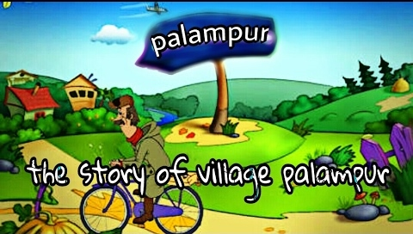

Slide 2
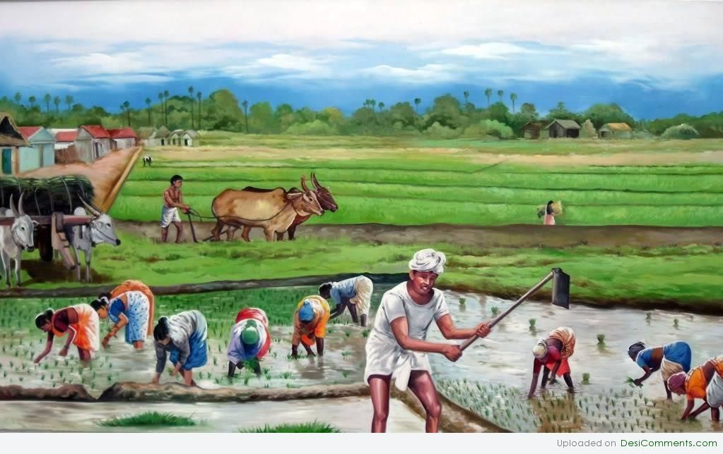
Palampur is an imaginary village. Agriculture is the main activity in Palampur.

Slide 3
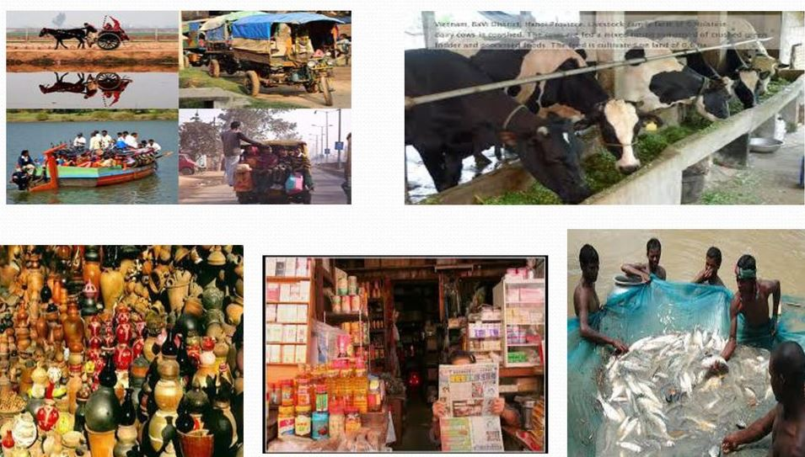
Other activities such as small scale manufacturing, dairy, transport, etc. are carried out on a limited scale in Palampur.

Slide 4
Palampur is well-connected with neighbouring villages and towns.
Raiganj, a big village, is 3 kms from Palampur.
An all weather road connects the village to Raiganj and further on to the nearest small town of Shahpur.

Slide 5
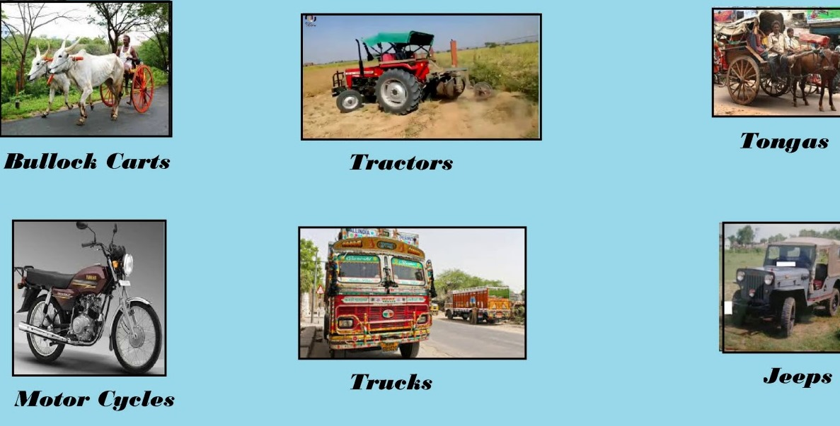
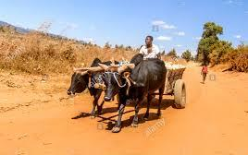
Many kinds of transport are found on the roads of Palampur

Slide 6
COMMUNITY LIFE IN PALAMPUR

Slide 7
450 families belonging to different castes live in Palampur.
Most of the lands are owned by the upper caste people.
They live in big houses made of bricks with cement plastering .
The SC s live in small houses made of mud and
straw.

Slide 8
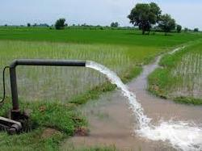
Most of the houses have electric connections. Electricity powers all the tube wells in the fields and is used in various types of small business.
various types of small business. Palampur
has two primary schools and one high
school.

Slide 9
Palampur has two primary schools and one high school.

Slide 10
There is a primary health centre run by the government and one private dispensary where the sick are treated.

Slide 11
We came across various production activities in Palampur.
In Indian villages, farming is the main production activity.
Nonfarm activities carried out in villages include small manufacturing, transport, shop-keeping, etc.

Slide 12
PRODUCTION
Production is a process in which raw materials (natural resources) are converted in to more useful finished goods.

Slide 14
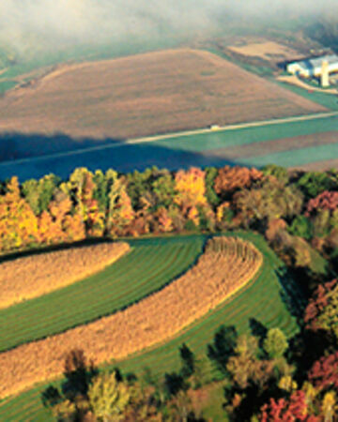
a. Land: In Economics, Land refers to all the natural resources .It includes land surface, water, forests, minerals etc.

Slide 15
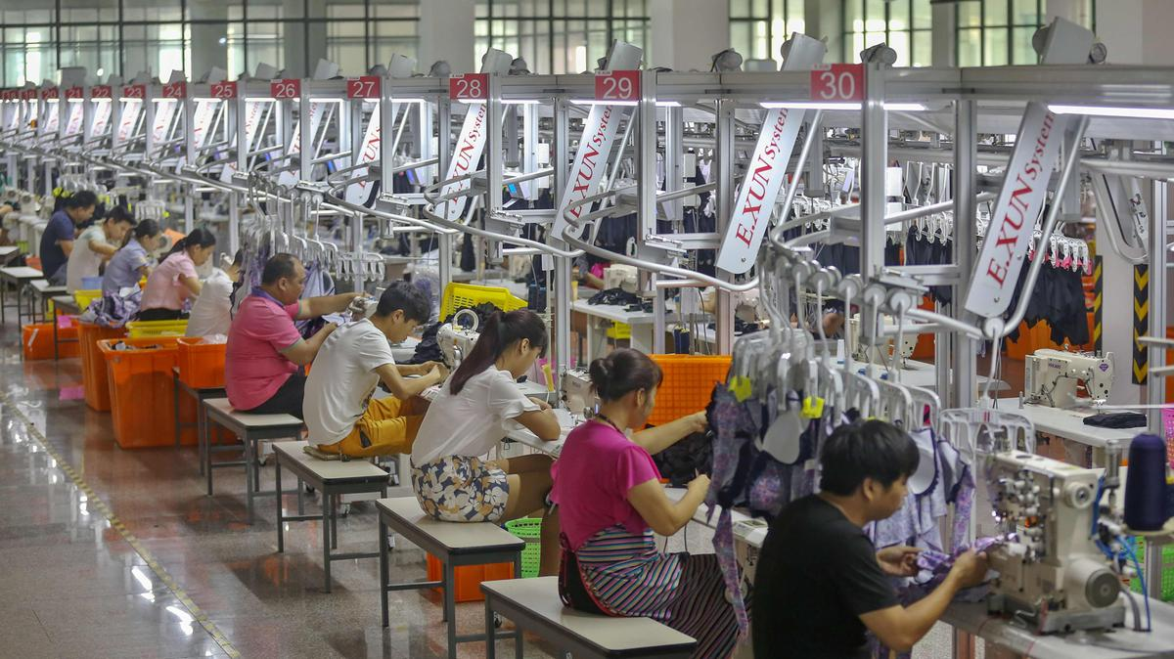
b. Labour:
Labour is the service provided by workers. Skilled and unskilled workers are needed to carry out production activities.

Slide 16
c. Physical Capital : Capital refers to manmade means of production.
It is of two types-
#. Fixed Capital-
Tools, machines and buildings, which are used in the production process constitute fixed capital.
#. Working Capital : Raw materials and money in hand are called working capital.

Slide 17
d. Human Capital(organisation) -
Educated and trained human beings with organisational ability are needed to put together land ,labour and physical capital and produce output.

Slide 18
LAND
Farming is the main production activity in Palampur.
75 per cent of the workers are dependent on farming for their livelihood. Some of them are farmers and others are farm labourers.
Land is a fixed asset. Two different methods can be used to increase output from the same area of Land. They are:
Multiple Cropping and Modern Farming Technology

Slide 19
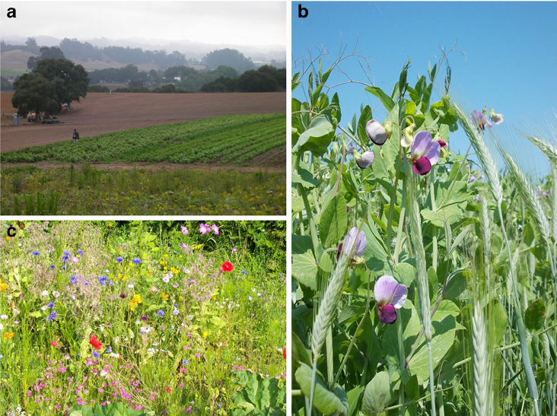
Multiple Cropping-
Cultivating more than one crop on a piece of land during the year is called Multiple Cropprng.
For ex: Jowar and bajra are grown in rainy season, potato in october-december and wheat in winter.

Slide 20
MODERN FARMING TECHNOLOGY

Slide 21
Modern farming technology:
It is also called HYV technology. It is a package of three inputs such as HYV seeds ,chemical fertilisers and pesticides and irrigation.
HYV technology helps us to increse productivity.
Ex: farmers of Punjab succeed increasing the production of wheat several times by using HYV technology.

Slide 22
GREEN REVOLUTION

Slide 23
GREEN REVOLUTION
New farming technology (HYV technology) was introduced in India in the late 1960 s .
As a result of it, agricultural production and productivity increased several times.
India could achieve self sufficiency in food grains.
These developments are generally called the Green Revolution.

Slide 24
NEGATIVE EFFECTS OF THE GREEN REVOLUTION.
a. Large scale use of chemical fertilisers destroyed the natural fertility of the soil.
b. Over exploitation of ground water resulted in the lowering of the water table.

Slide 25
DISTRIBUTION OF LAND IN PALAMPUR
Land is distributed unequally.
Nearly one-third of the 450 families are landless.
240 families have small pieces of land (less than 2 hectares) .
60 rich families have large pieces of land.

Slide 26
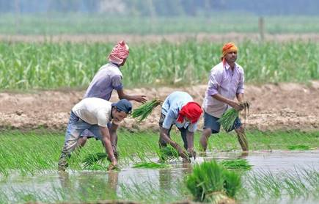
FARM LABOURERS IN PALAMPUR
Palampur is a labour surplus village .
There is heavy competition for work among the labourers.
So, people agree to work for lower wages.

Slide 27
CAPITAL
Medium and large farmers sell a major part of their output in the market .
They save a part of their income. This money is used as capital for the next season.
Small farmers consume most of their output. They do not have surplus to sell.
So, they take loan from big farmers to use as capital.

Slide 28
SAVITA : A SMALL FARMER
Savita borrowed money from the land lord named Tejpal under the following conditions:
She should work in Tejpal's farm during harvesting season for a wage of Rs.35 per day.
She should pay interest at the rate of 24%.
Savita's condition would be better if she could get a bank loan
a. Bank charges very low rate of interest .She can repay the loan easily.
b. There is no need for her to work in another person's land.

Slide 29
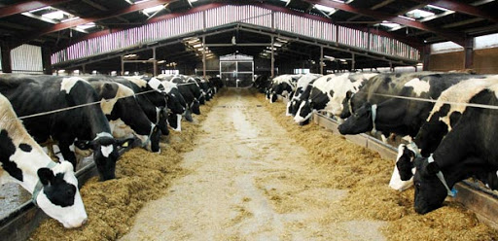
NON- FARMING ACTIVITIES
DAIRY FARMING

Slide 30
DAIRY FARMING: Rearing of milk giving animals and the production of milk products is called Dairy Farming.
People feed their buffalos on grass and the jowar and bajra that grows during the rainy season.
The milk is sold in Raiganj.
Two traders have set up collection cum chilling centres at Raiganj from where the milk is transported to far away towns and cities.

Slide 31
SMALL SCALE MANUFACTURING

Slide 32
SMALL SCALE MANUFACTURING:
Artisans work at home and produce goods on small scale without using machines.
The family members of the artisans are also involved in production activities.
Most of the work is done by hand. Only simple tools are used.
It is called cottage industries.

Slide 33
The shopkeepers of Palampur

Slide 34
The traders of Palampur are shopkeepers.
They buy goods from wholesale markets in the cities and sell them in the village.
There are small general stores in the village selling a wide range of items like rice, wheat, sugar, tea, oil, biscuits, soap, toothpaste, batteries, candles, notebooks, pen, pencil, even some cloth.

Slide 35
THANK YOU

